Slide 1
JMU Parking Lot App
Presented by Anaseli Marcos-Martinez
And Chandler Lopez
And Alan Pak
Notes:
Alan

Slide 2
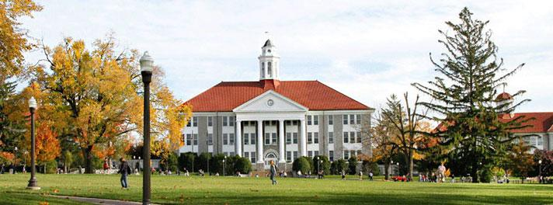
Who are we?
Notes:
Seli
JMU Students
Commuters
I currently have to arrive before 8:30 am everyday or else i'm likely gonna not have a parking spot
This is an app that personally relates to us
Picture: https://www.jmu.edu/univlegal/

Slide 3
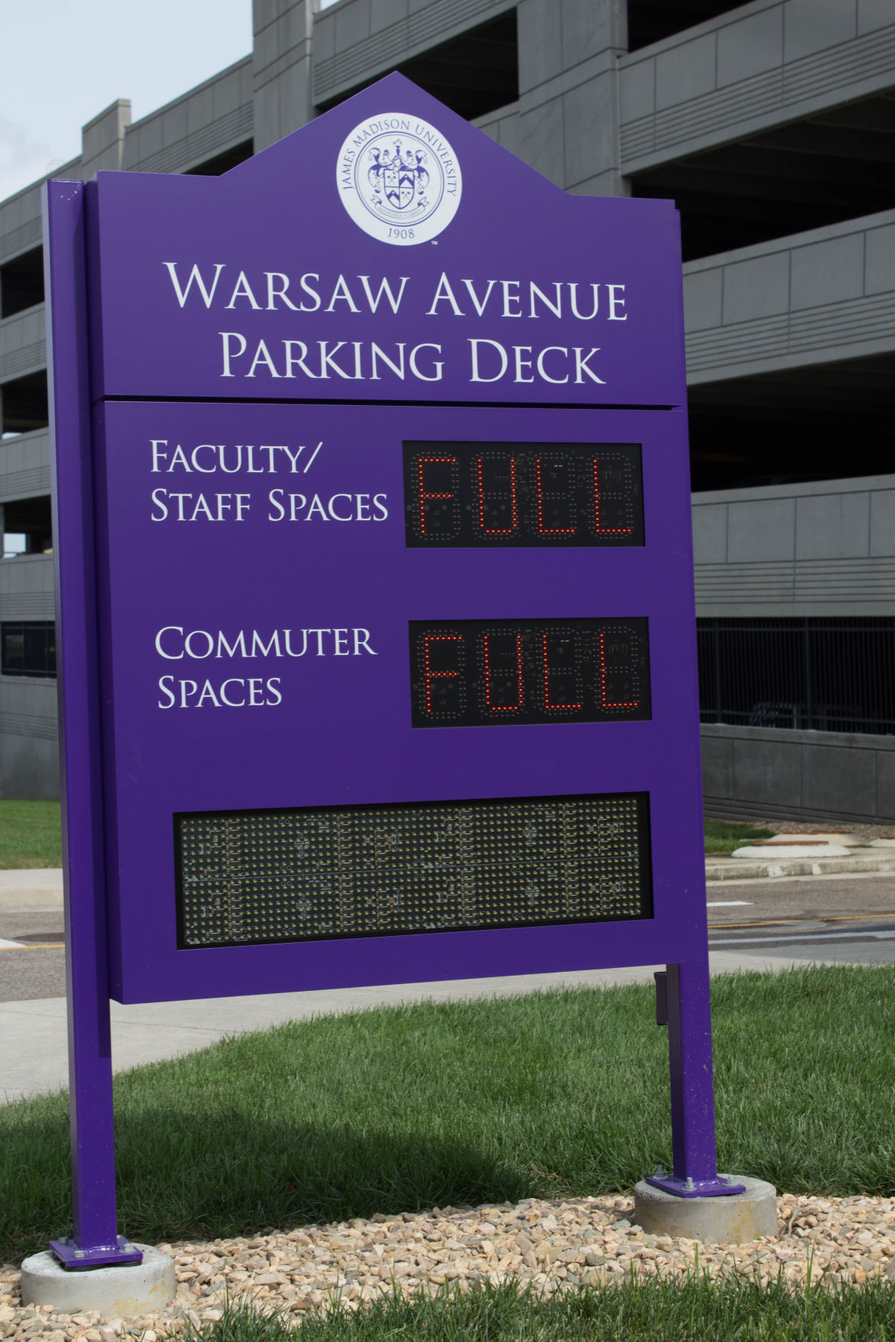
The Problem
Notes:
Alan
When trying to park on campus it is impossible to know if/ where open parking spots may be
There are many parking spaces on campus but only a limited amount of locations have the ability to show availability
Picture: https://www.breezejmu.org/news/jmu-students-express-concerns-about-parking-on-campus/article_143bc6ba-a3c0-11e7-b7da-134f45947d12.html

Slide 4
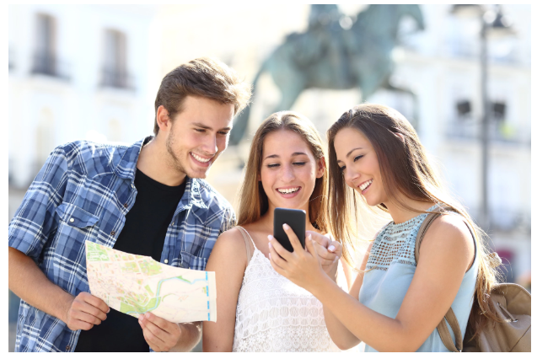
Target Goals
Notes:
Chandler
Target Goals:
Create a user friendly app for students and faculty.
General idea is to add some motion detector to parking spots, and an interface for your phone
This would help reduce time for commuter students to get class in time.
Faculty won’t have to worry about students taking their parking spots.
Do this by showing accurate parking spot availability for each individual spot.
Picture: https://www.telegraph.co.uk/travel/lists/the-worlds-friendliest-cities-how-to-be-friendly/

Slide 5
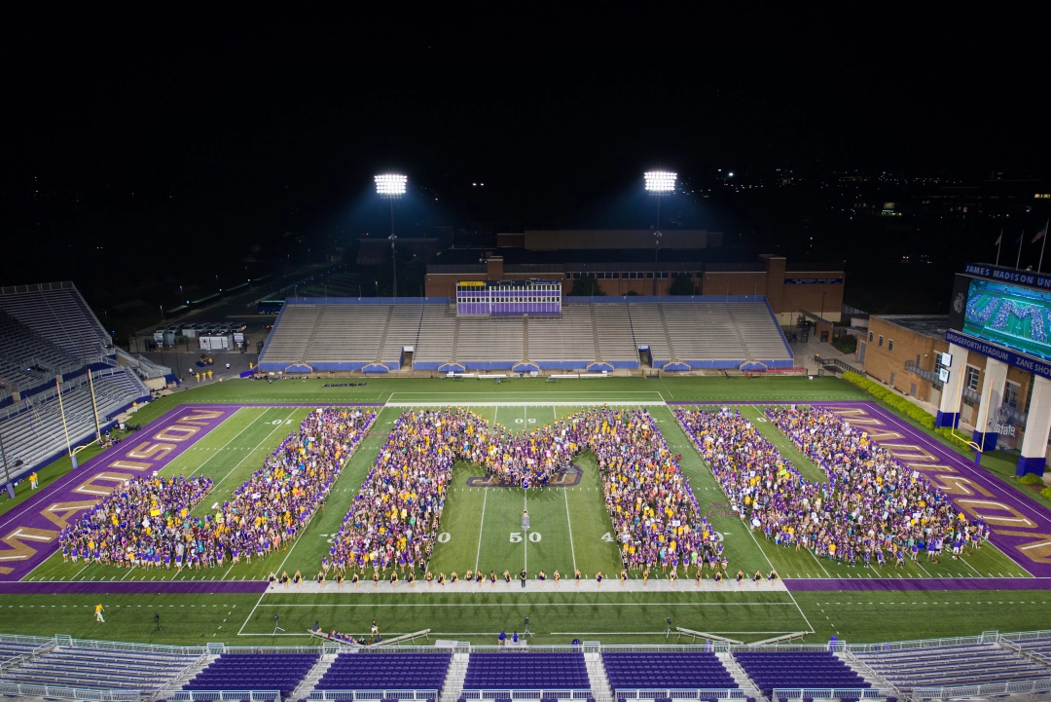
StakeHolders
Notes:
Seli
StakeHolders
The current Target for this potential app is the JMU student body
Commuters currently pay hundreds of dollars
However they aren't even guaranteed a parking space
Currently on the east side of campus you are unlikely to receive a spot if you arrive after 8:30
Students then either
are late for class
miss the class all together
or park where they aren't supposed to be and get a ticket
Pitcure: https://jmusocialmedia.files.wordpress.com/2016/08/234046-1787-jmu-letters-in-stadium-1008.jpg?w=1080

Slide 6
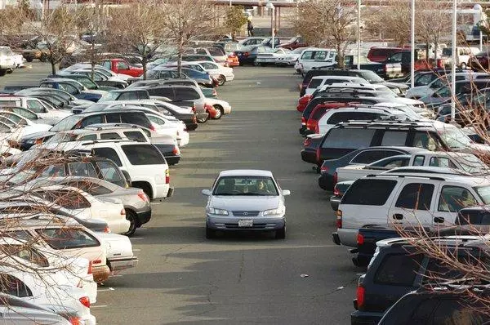
Interest Groups
Notes:
Alan
Interest Groups: anyone who might consider this app in the future
Anywhere with a parking problem
This can include...
Other schools
Stores
Restaurants
Or really anywhere with a parking lot
Picture: https://www.eastbaytimes.com/wp-content/uploads/2016/07/20140103__bartpark31.jpg?w=600

Slide 7

Things to Consider
Notes:
Chandler
Cost Analysis
Are there cheaper options out there?
Current viable solutions
Are there alternatives already in place that need to be taken advantage of?
Feasibility
Is it practical to do all the physical and digital work necessary for this to become reality?
Similar solutions that could be used for inspiration
What could we use to make this process easier?
Picture: https://st3.depositphotos.com/2801893/13749/v/1600/depositphotos_137495514-stockillustratie-uitdaging-probleem-oplossen.jpg

Slide 8
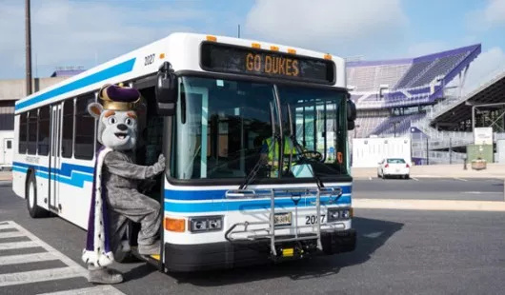
Other Solutions
Notes:
Seli
Parking garages have the app
Pros: works for parking garages
Cons: Only works for parking garages
Carpooling:
Pros: saves parking spaces overall
Cons: Must arrive and leave at the same time in the same place
Alternate Forms of Transportation:
Pros: take an Uber to school
Cons: It gets expensive in the long run
Bus:
Pros: Free, Guaranteed ride
Cons: Must be able to catch a bus, strict schedule
Picture: https://i0.wp.com/www.jmu.edu/_images/commencement/P1040556-1.jpg?resize=530%2C310

Slide 9
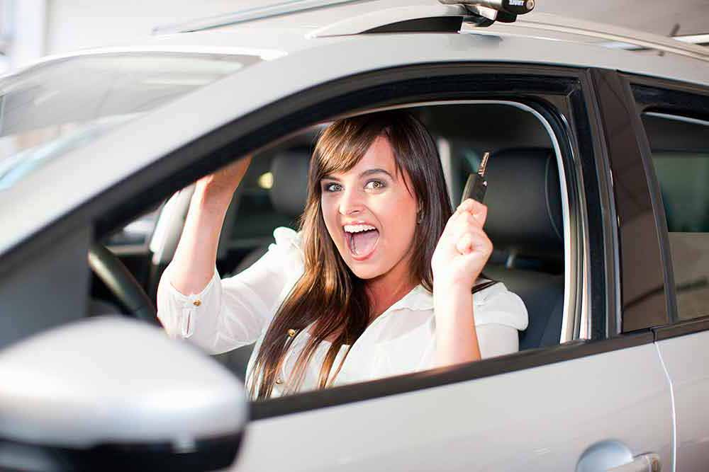
Potential
What would happen if this app was successful?
Notes:
Chandler
If this app was successfully implemented
Students could potentially find parking spots much quicker
Leads to less tickets
Less late or missed classes
Faculty and staff could also have access to the app
Other companies with restricted parking could utilize it
Picture: http://okpecs.hu/wp-content/uploads/2016/12/469796-166262177-edited-1.jpg

Slide 10
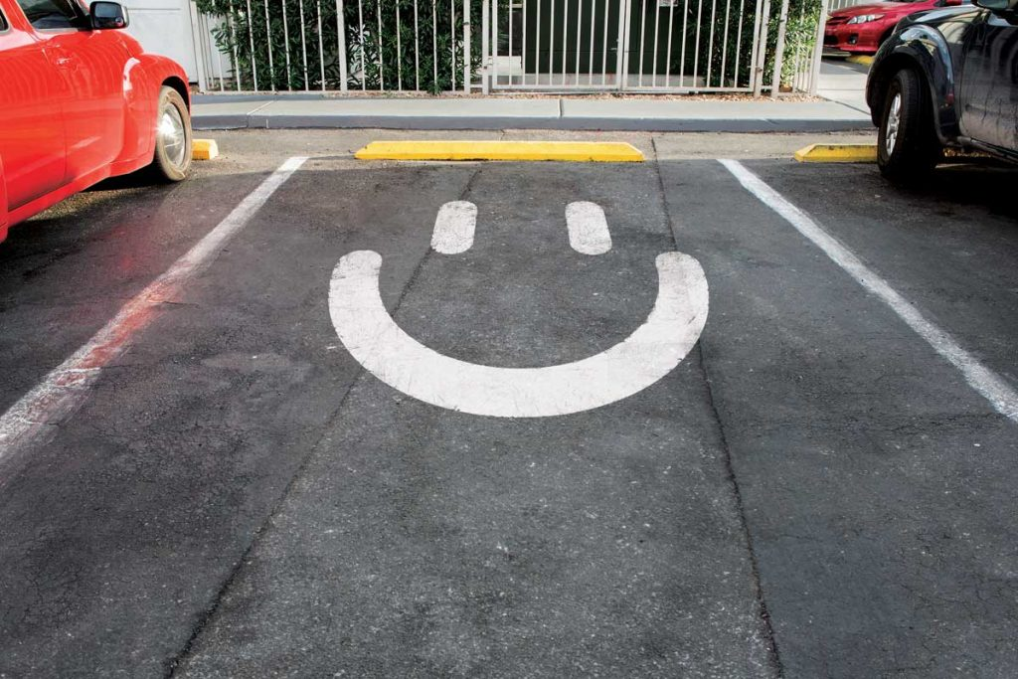
Conclusion
Notes:
Alan
Conclusion:
This app will not only help students and faculty find parking on campus but also help parking services to limit the amount of parking passes sold each academic year.
Picture: https://justonetrip.org/tag/98125/

Slide 11
Sources/Pictures
https://i0.wp.com/www.jmu.edu/_images/commencement/P1040556-1.jpg?resize=530%2C310
https://jmusocialmedia.files.wordpress.com/2016/08/234046-1787-jmu-letters-in-stadium-1008.jpg?w=1080
https://justonetrip.org/tag/98125
http://okpecs.hu/wp-content/uploads/2016/12/469796-166262177-edited-1.jpg
https://st3.depositphotos.com/2801893/13749/v/1600/depositphotos_137495514-stockillustratie-uitdaging-probleem-oplossen.jpg
https://www.breezejmu.org/news/jmu-students-express-concerns-about-parking-on-campus/article_143bc6ba-a3c0-11e7-b7da-134f45947d12.html
https://www.eastbaytimes.com/wp-content/uploads/2016/07/20140103__bartpark31.jpg?w=600
https://www.jmu.edu/univlegal/
https://www.telegraph.co.uk/travel/lists/the-worlds-friendliest-cities-how-to-be-friendly/
Harrington, Kevin. “10 Qualities Of A Successful Product.” Forbes, Forbes Magazine, 9 Oct. 2013, www.forbes.com/sites/kevinharrington/2013/10/08/10-qualities-of-a-successful-product/#4ad620ff126b.
Cummings, Caroline, et al. “9 Things That Take a Pitch From Good to Great.” Bplans Blog, Palo Alto Softwares, 30 June 2018, https://articles.bplans.com/9-things-that-take-a-pitch-from-good-to-great/
https://www.youtube.com/watch?v=5iKitGJeAZ4

